Slide 1

Git Workflows
Patricia Grubel
Los Alamos National Laboratory
James M. Willenbring Sandia National Laboratories
Jared O’Neal
Argonne National Laboratory
Better Scientific Software Tutorial, SC20, November 2020
See slide 2 for license details
LA-UR-20-27704
Notes:
Designed to be 30 Minute Talk.
15 minute talk: Explain main areas including the mechanisms needed for the workflow Branches, Pull Requests and Forks. Go through complex workflow examples quickly.
Make sure to cover considerations for your project slide 19,
If time allows introduce the demo slide mention Jim’s contribution, the process one would go through is the first slide maybe emphasize CI and mention the talk to come.

Slide 2
License, Citation and Acknowledgements
License and Citation
This work is licensed under a Creative Commons Attribution 4.0 International License (CC BY 4.0).
The requested citation the overall tutorial is: David E. Bernholdt, Anshu Dubey, Patricia A. Grubel, Rinku K. Gupta, Better Scientific Software tutorial, in SC ‘20: International Conference for High Performance Computing, Networking, Storage and Analysis, online, 2020. DOI: 10.6084/m9.figshare.12994376
Individual modules may be cited as Speaker, Module Title, in Better Scientific Software tutorial…
Acknowledgements
Additional contributors include: Mike Heroux, Alicia Klinvex, Mark Miller, Jared O’Neal, Katherine Riley, David Rogers, Deborah Stevens, James Willenbring
This work was supported by the U.S. Department of Energy Office of Science, Office of Advanced Scientific Computing Research (ASCR), and by the Exascale Computing Project (17-SC-20-SC), a collaborative effort of the U.S. Department of Energy Office of Science and the National Nuclear Security Administration.
This work was performed in part at the Argonne National Laboratory, which is managed by UChicago Argonne, LLC for the U.S. Department of Energy under Contract No. DE-AC02-06CH11357.
This work was performed in part at the Oak Ridge National Laboratory, which is managed by UT-Battelle, LLC for the U.S. Department of Energy under Contract No. DE-AC05-00OR22725.
This work was performed in part at the Lawrence Livermore National Laboratory, which is managed by Lawrence Livermore National Security, LLC for the U.S. Department of Energy under Contract No. DE-AC52-07NA27344.
This work was performed in part at the Los Alamos National Laboratory, which is managed by Triad National Security, LLC for the U.S. Department of Energy under Contract No.89233218CNA000001
This work was performed in part at Sandia National Laboratories. Sandia National Laboratories is a multi-mission laboratory managed and operated by National Technology and Engineering Solutions of Sandia, LLC., a wholly owned subsidiary of Honeywell International, Inc., for the U.S. Department of Energy’s National Nuclear Security Administration under contract DE-NA0003525.

Slide 3
Content
Brief explanation of Version Control with Git
Git Workflow Mechanisms for Collaboration
Branches
Pull Requests
Forks
Exposure to workflows of different complexity
What to think about when evaluating different workflows
Extra: Heat Equation Example Workflow
Notes:
Talk is more of a conversation where we form a common understanding of workflows and related issues by looking at different examples. These workflows are meant to serve as examples and might not be appropriate for others talks.
I received positive comments regarding this talk when given at ATPESC. It appears that conversation by example is more interesting and engaging. I found that compared to the testing talk, many people were following the talk rather than working on their laptops.

Slide 4
Goal
Development teams would like to use version control to collaborate productively and ensure correct code.
Notes:
Talk is more of a conversation where we form a common understanding of workflows and related issues by looking at different examples. These workflows are meant to serve as examples and might not be appropriate for others talks.
I received positive comments regarding this talk when given at ATPESC. It appears that conversation by example is more interesting and engaging. I found that compared to the testing talk, many people were following the talk rather than working on their laptops.

Slide 5
First Workflow
This process of collaborating via Git is called the Centralized Workflow
See Atlassian/BitBucket for more information
“Simple” to learn and “easy” to use
Leverages local vs. remote repo dimension
Integration in local repo when local repos interact with remote repo
What if you have many team members?
What if developers only push once a month?
Lengthy development efforts without integrating
Occasional contributors
What if team members works on different parts of the code?
Working directly on master
Remote repo
Local repo
Alice
Local repo
Bob
Notes:
Mention that simple and easy here do not imply that it is simple and easy for those just introduced to DVCS. Rather, it means relative to those workflows that will be introduced.
Many team members means that with a single pull I might have conflicts related to work by five different developers. I would need to work with each to resolve.
Only pushing once a month means that all repos could start to diverge significantly. Harder to resolve. Also, their work is hidden. I might be working on same code or I might want something that they have done.
Skip over “What if team members works on different parts of the code?” for the interest of time.
Last point is described in words by explaining that, as can occur with development, some commits will be broken. This means that a user of the repository that would like to use a historic commit needs to know which are good and which are bad. While we can accomplish this to some degree with commit messages and tags (what happens if we find out it is broken much later?), we want to work toward something better. We introduce branches as a step in that direction. Therefore, this flows into the next slide.

Slide 6
Git Workflow Mechanisms for Collaboration
Branches
Enable separate development for features or fixes on the same repo
Enables different types of Workflows
Pull Requests
Enables code review and testing before merge
Forks
Enables outside contributors that have read access only
Controls on original repo remains with the team
Notes:
Note: Communication among team members is still vital when working on various branches.

Slide 7
Branches
Branches are independent lines of development
Use branches to protect master branch
Feature branches
Organize a new feature as a sequence of related commits in a branch
Branches are usually combined or merged
Develop on a branch, test on the branch, and merge into master
Integration occurs at merge commits
Notes:
Use Point of a branch is independent development and protecting master to some level. However, working with branches is only sensible if we can add the work into master once it has matured to a good state and could be used by users. In this sense, we are expressing that the latest commit on master should always be working.
fast-forward scenario as nice understanding of branch. Dog-leg is only to emphasize that FeatureA is a branch. However, we realize that it still represents a linear history of work. We like fast-forward merges as these do not have an associated conflict.
Use second case to highlight normal branch states and to introduce merge commits. Graph show two long-lived feature branches and race condition. Cannot do a fast forward on one branch without losing other commits.
For the first branch, the merge commit was simple as FeatureA and master did not diverge – everything in master is also in FeatureA.
However, when FeatureB is to be merged into master, there is a commit on master that is not on FeatureB => the two branches have diverged slightly. The VCA must study the divergence and determine if there were conflicting changes made.

Slide 8
Control Project Branch Complexity
Workflow policy is needed
Project supported branches and workflows should not be unnecessarily complex
Individuals and sub-teams can leverage more complex models when advantageous
Descriptive names or linked to issue tracking system
Where do branches start and end?
Notes:
What if stuff was being developed by Dev1 and Dev2 decided to merge in a without communicating? Consider that case that stuff was just for tinkering and was not necessarily meant to ever be in master.
Don’t dwell much on this. Naming rule is clear and we can point out here that having unexpressive names like a,b,stuff is missing the opportunity to use the graph as communication to other developers. Point out that basing a branch off of a branch other than master might be a good or a bad thing depending on team. As an example, mention that a and stuff are being developed by different people. If a is merged into stuff without prior consent, that this could lead to both technical and social difficulties.

Slide 9
Feature Branches
Extend Centralized Workflow
Remote repo has commits A & B
Bob pulls remote to synchronize local repo to remote
Bob creates local feature branch based on commit B
Commit C pushed to remote repo
Alice pulls remote to synchronize local repo to remote
Alice creates local feature branch based on commit C
Both develop independently on local feature branches
Notes:
With this we are creating a new variant of the Centralized workflow.
Walk through entire timeline in detail to help understand what can happen when collaborating via git and to hammer home the idea of local/remote synchronization.

Slide 10
Feature Branch Divergence
Alice integrates first without issue
Alice does fast-forward merge to local master
Alice deletes local feature branch
Alice pushes master to remote
Meanwhile, Bob pulls master from remote and finds Alice’s changes
Merge conflict between commits D and E
Notes:
Fast-forward merge means that there has been no divergence between the two branches. This can happen between two branches in a single repo or the same branch on two local repos.
Alice has fast-forward merge, which is simple to understand, has no merge conflicts. Her repo is synchronized with remote.
Let’s imagine that they both made changes to the same part of loops.cpp. Therefore, we again have a merge conflict. Therefore, Bob’s repository is in a difficult state.

Slide 11
Feature Race Condition
Integration occurs on Bob’s local repo
Bob laments not having fast-forward merge
Bob rebases local feature branch to latest commit on master
E based off of commit B
E’ based off of Alice’s commit I
E’ is E integrated with commits C, D, F, G, I
Merge conflict resolved by Bob & Alice on Bob’s local branch when converting commit E into E’
Can test on feature branch and merge easily and cleanly
See Atlassian/BitBucket for a richer Feature Branch Workflow
Notes:
Majority of participants were aware of rebase
Leverages local vs. remote dimension
Not necessary to understand the details of rebase. Just the idea of rebasing to get fast-forward merge and that we get merge conflicts at rebase.
Bob will use rebase to slide his feature branch along so that it is now based off of latest commit on master. This is not for free. We create E’ from E intergrated with C-I. This means that version control system will discover the merge conflict when establishing E’, pause rebase, let user resolve conflict.
Gloss over rebase here. In previous talks, it appears that many people are aware of rebase. Main idea is that we are controlling where, when, and how we find conflicts and resolve these.

Slide 12
More Branches
Branches with infinite lifetime
Base off of master branch
Exist in all copies of a repository
Each provides a distinct environment
Development vs. pre-production
Notes:
Explain two rules. Raise the topic of why impose rules such as these? Why not let users capitalize on full expressivity of git? These are valid questions. For this case, imposing these rules limits complexity and we find common, simple use patterns emerging. Because of this, we can make well-defined statements such as “all changes made to master were first made to development”. Therefore, master is a subset of development and these two infinite lifetime branches cannot diverge in a significant way.
For the graphic, the workflow was simple. There is no possibility of a merge conflict. No real integration occurring since second branch is based off of first branch’s commit merge on master.
I did not mention this, but if we get simple use patterns emerging, the graph history can be simpler – no rats nest of branches. This can mean that it is easier to follow the progression of work and make it easier and less error prone for those who must approve merges into master.

Slide 13
Pull Requests
Review and testing before merge
Alerts others about changes in branch before merge
Discussions ensue with possible follow up commits
Can request reviewer
Set policies for merge

Slide 14
GitHub Forks
A “fork” of a repository is a complete copy of another repository, inside a different GitHub account.
Forking requires read access to the main (often referred to as “upstream”) repository
Forks of public repositories are public
Other users can be granted write access to your fork
You cannot fork a fork
Does not copy issues or pull requests
Use branches within your fork (do not modify master)
A pull request (GitLab uses “merge request”) can be used to suggest changes to the upstream repository
Added benefit: pull requests from forks prevent huge numbers of branches on the upstream repository

Slide 15
Example Workflows of Different complexity
Trilionos Workflow
Git Flow
Github Flow
Gitlab Flow

Slide 16
Current Trilinos Workflow
Workflow designed so that
All commits in master are in develop
Merge conflicts exposed when integrating into develop
Merge conflicts never occur when promoting to master
Test-driven workflow
Feature branches start and end with develop
All changes to develop must come from GitHub pull requests
Feature branches are merged into develop only after passing pull request test suite
Change sets from develop are tested daily for integration into master
master
develop
develop -> master testing
Pull request testing
Issue 1
Issue 2
Notes:
Emphasize word current here. We started with Feature Branch Workflow and opted for something more complex. This presently works, but might not as team grows/code grows.
We started with little policy during initial exploration/prototyping feature branch. We were only three developers and could easily coordinate work so that our efforts were non-overlapping. As more developers began working and our efforts changed, we began stepping on each others’ toes. This necessitated increasing the complexity. Also, desire to protect master.
Development should contain everything in master and possibly more.
Staged should contain everything in master and possibly more.

Slide 17
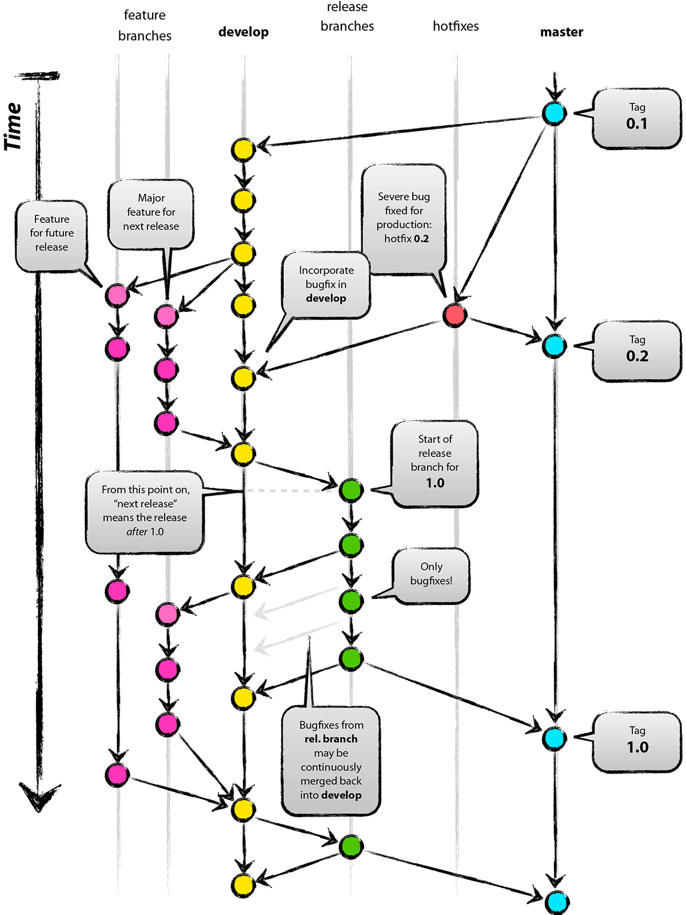

Git Flow
Full-featured workflow
Increased complexity
Designed for SW with official releases
Feature branches based off of develop
Git extensions to enforce policy
How are develop and master synchronized?
Where do merge conflicts occur and how are they resolved?
Author: Vincent Driessen
Original Blog: https://nvie.com/posts/a-successful-git-branching-model/
License: Creative Commons
Notes:
Updated site for blog and picture has tag numbers.

Slide 18
GitHub Flow
http://scottchacon.com/2011/08/31/github-flow.html
Published as viable alternative to Git Flow
No structured release schedule
Continuous deployment & continuous integration allows for simpler workflow
Main Ideas
All commits in master are deployable
Base feature branches off of master
Push local repository to remote constantly
Open Pull Requests early to start dialogue
Merge into master after Pull Request review

Slide 19
GitLab Flow
https://docs.gitlab.com/ee/workflow/gitlab_flow.html
Published as viable alternative to Git Flow & GitHub Flow
Semi-structured release schedule
Workflow that simplifies difficulties and common failures in synchronizing infinite lifetime branches
Main Ideas
Master branch is staging area
Mature code in master flows downstream into pre-production & production infinite lifetime branches
Allow for release branches with downstream flow
Fixes made upstream & merged into master.
Fixes cherry picked into release branch
Notes:
The main downside to Git Flow for them is that
It is more complex than needed
You have to make certain that hot fixes and releases are merged back into develop (synchronize infinite lifetime branches). Common point of failure!
Having development on develop branch is annoying as many tools default to master as the main branch.
The main downside of GitHub flow is that it assumes that every commit to master is deployable. This might be overly simplified for most real cases. They incorporate other infinite branches to deal with this shortcoming. They also allow for the possibility of releases.
Flow downstream is like what we have with FLASH.

Slide 20
Considerations for Choosing a Git Workflow
Want to establish a clear set of polices that
results in correct code on a particular branch (usually master),
ensures that a team can develop in parallel and communicate well,
minimizes difficulties associated with parallel and distributed work, and
minimizes overhead associated with learning, following, and enforcing policies.
Adopt what is good for your team
Consider team culture and project challenges
Assess what is and isn’t feasible/acceptable
Start with simplest and add complexity where and when necessary

Slide 21
Extra: Demo for Heat Equation Example Workflow
Fork repository (once)
Clone the fork (once)
Create and checkout branch
Base branch on current development or other appropriate version for each feature
Modify and commit code
Push change to fork
Issue pull request to upstream repository
Review pull request
CI testing (covered in upcoming module)

Slide 22
Git Workflow for the Heat Equation Example
Developers
Work on feature branches in their forks
Using forks requires contributors to have only read-access to primary repository
Issue pull requests for changes
Natural opportunity to review and test all changes
Pull requests
Are reviewed by at least one developer (not the author)
Undergo CI testing prior to merging

Slide 23
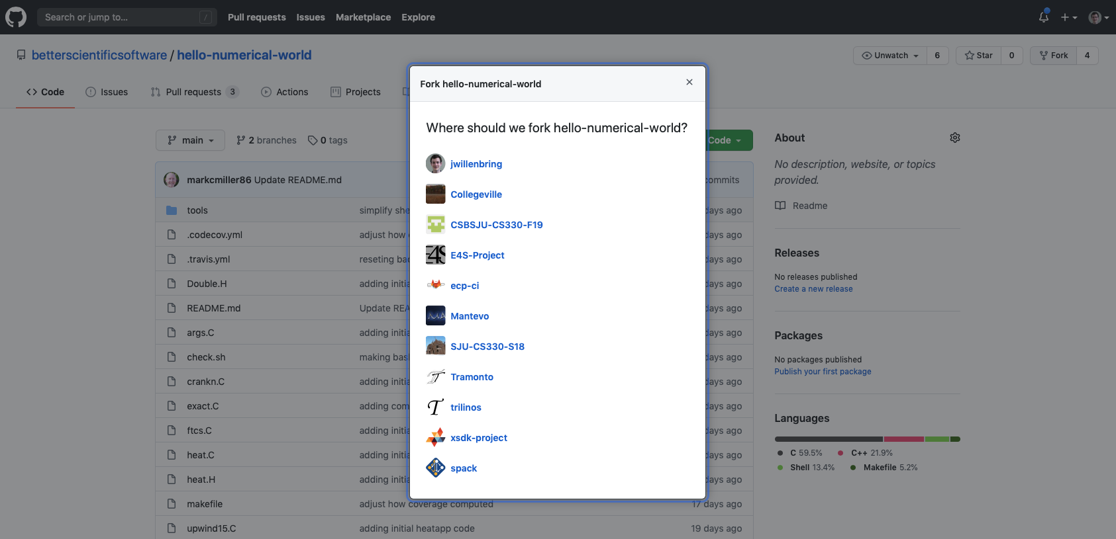
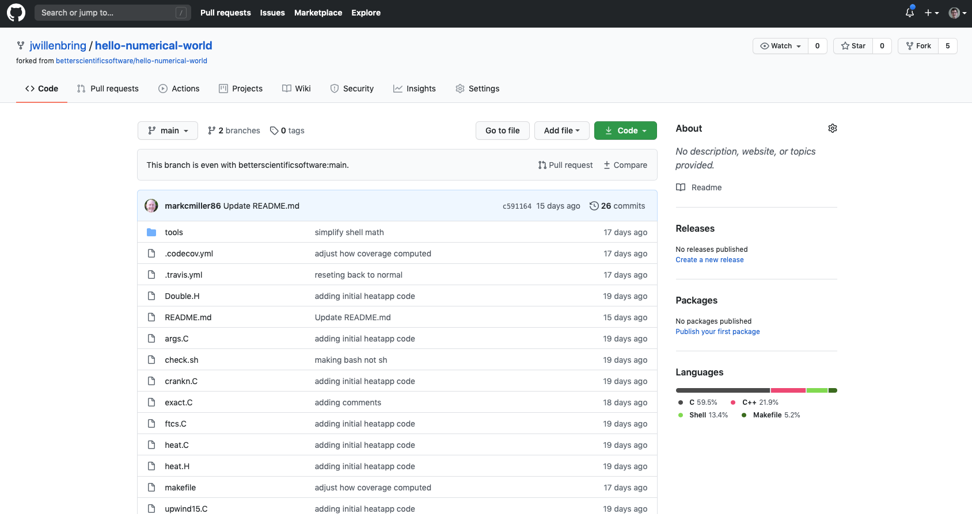
Fork the Repository

Slide 24
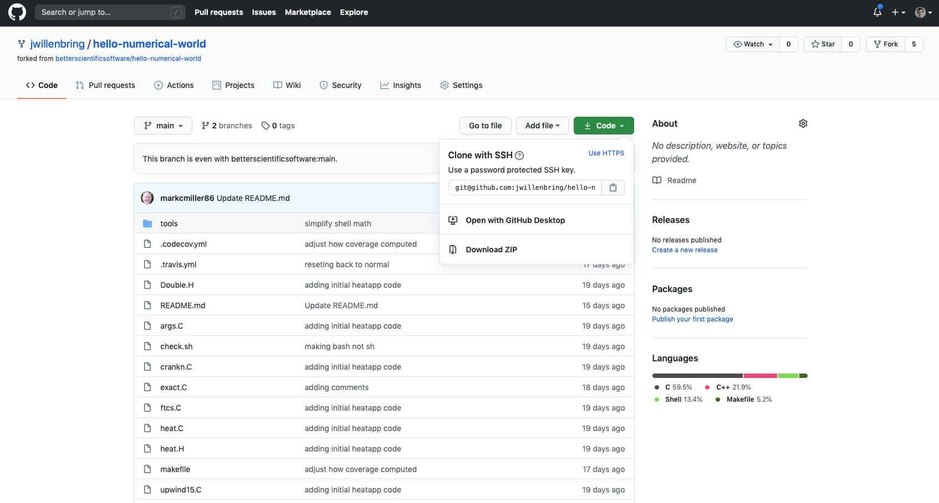
Find the Path to Clone

Slide 25
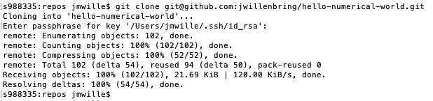
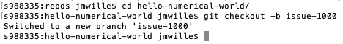
Clone the fork; Create and Checkout a New Branch

Slide 26
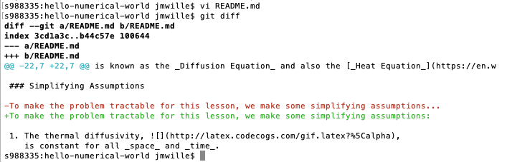
Modify and Commit Code

Slide 27
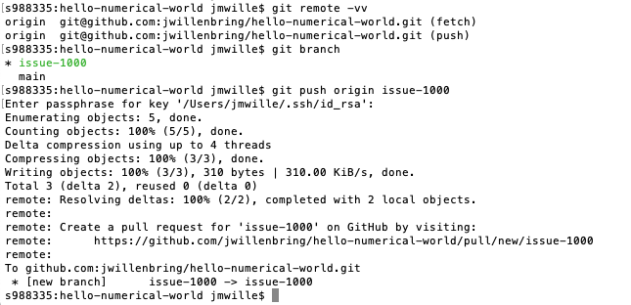
Push Change to Fork

Slide 28
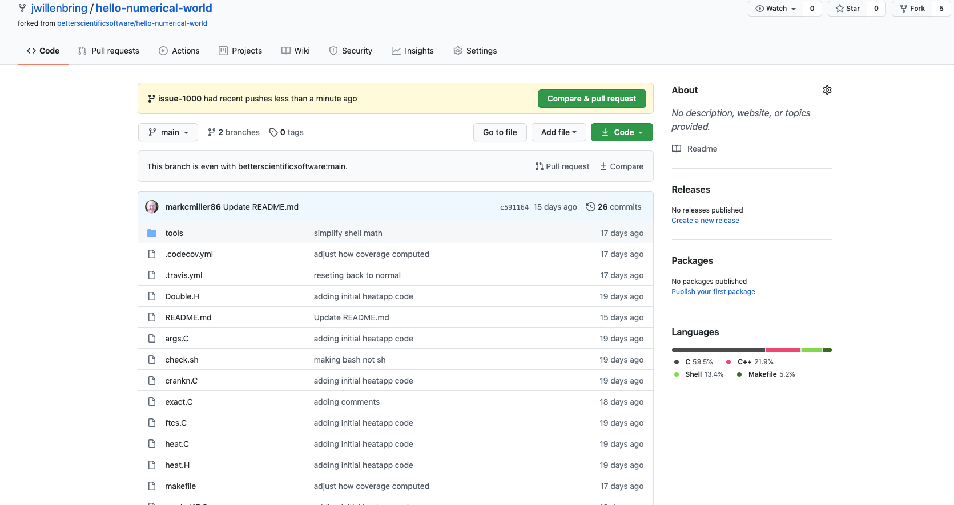
Issue Pull Request to Upstream Repository

Slide 29
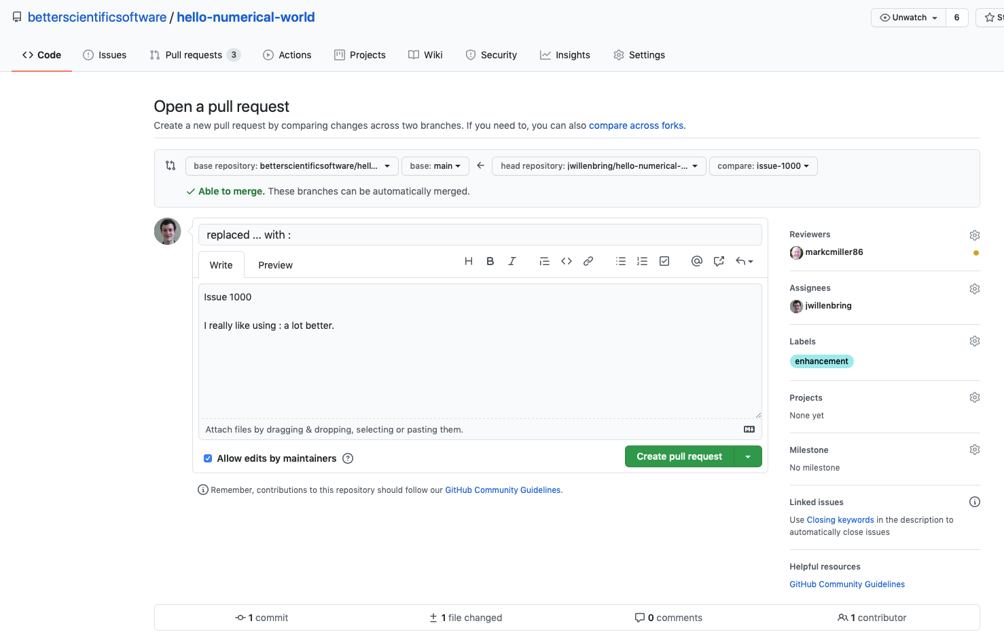
Issue Pull Request to Upstream Repository

Slide 30
Review Pull Request

Slide 31
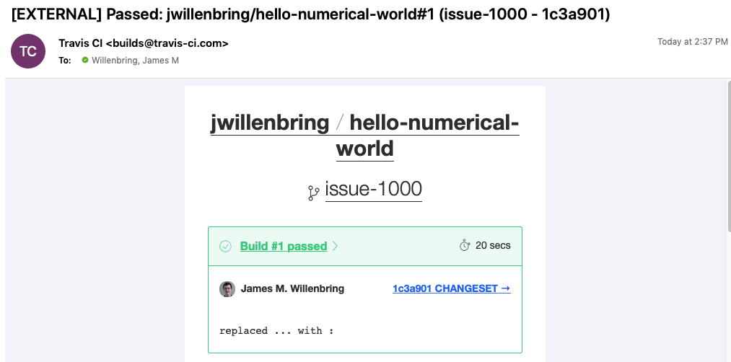
CI Testing for PR
This will be covered in the CI module

